Slide 1
IP HEADER FORMAT

Slide 2
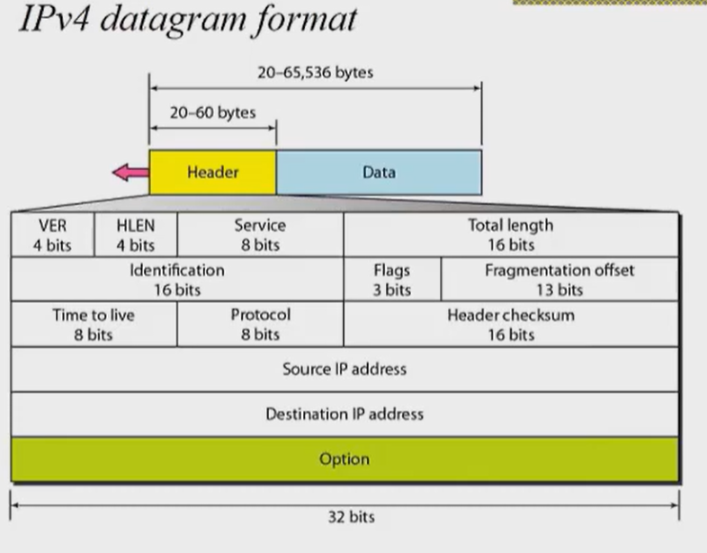

Slide 3
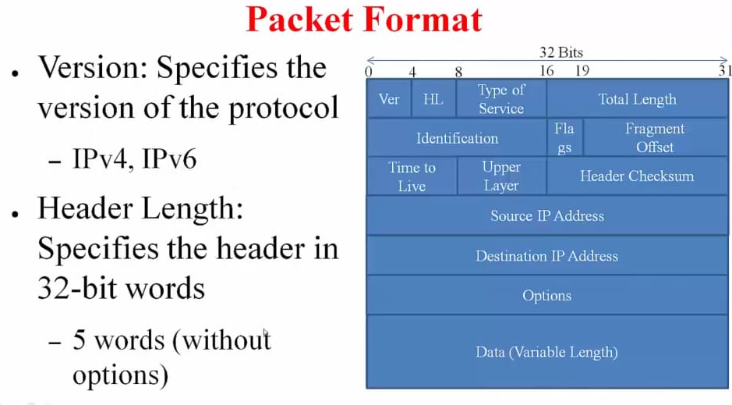

Slide 4
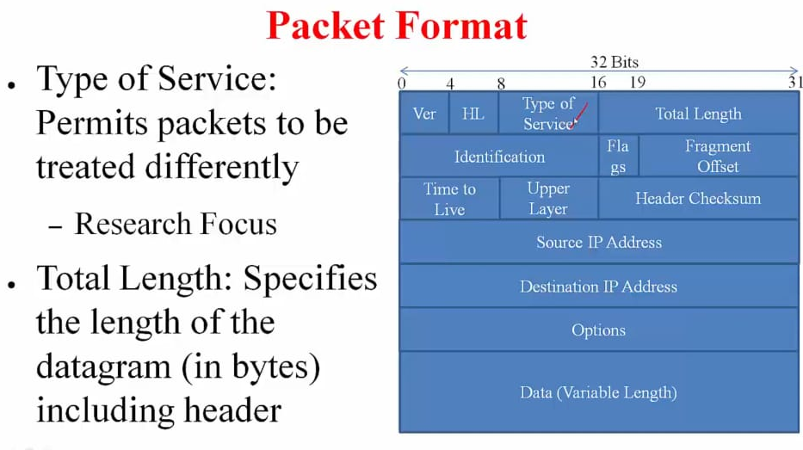

Slide 5
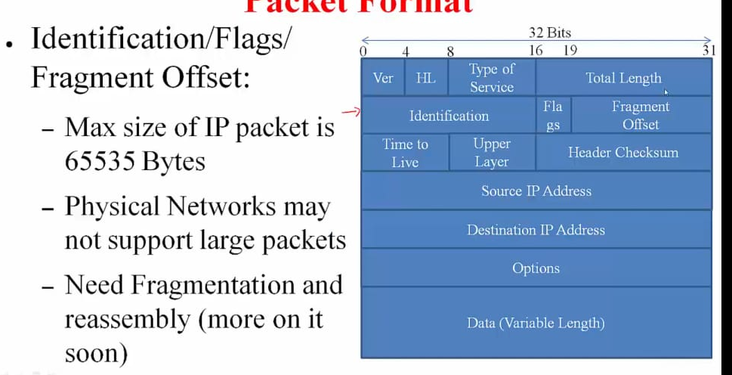

Slide 6
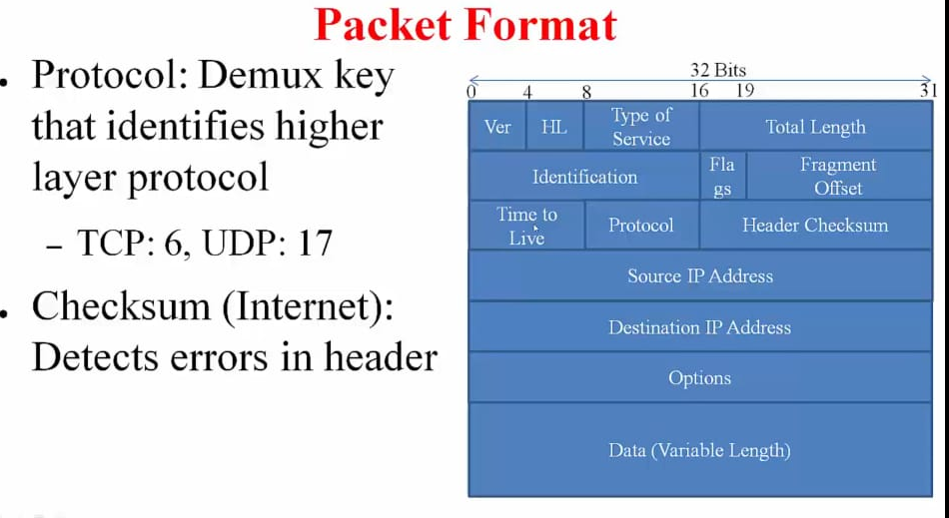

Slide 7
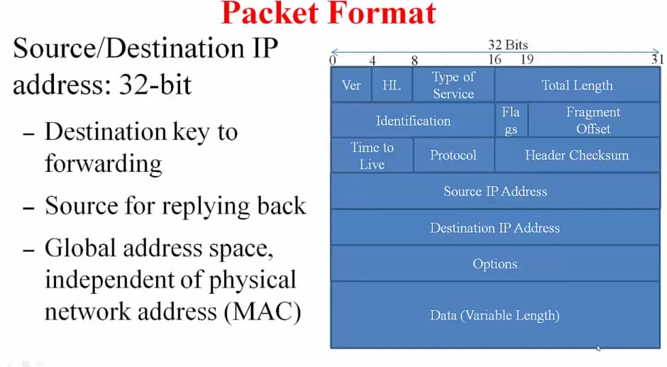

Slide 8
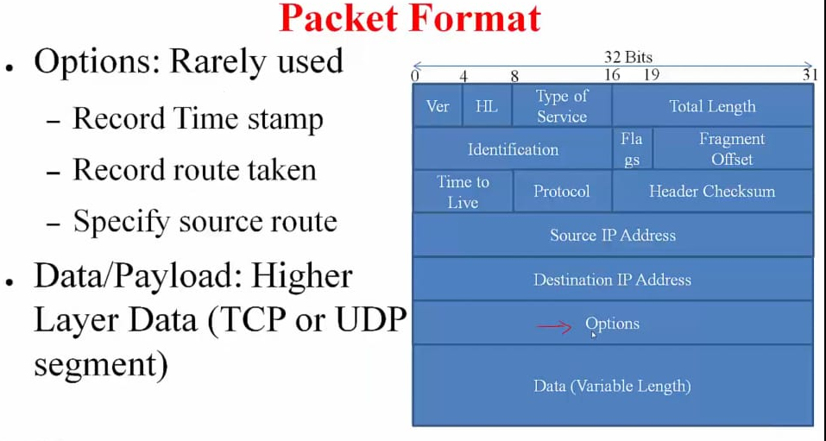

Slide 9
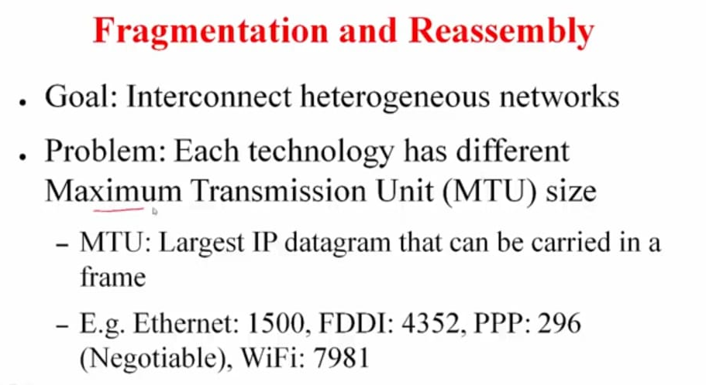

Slide 10
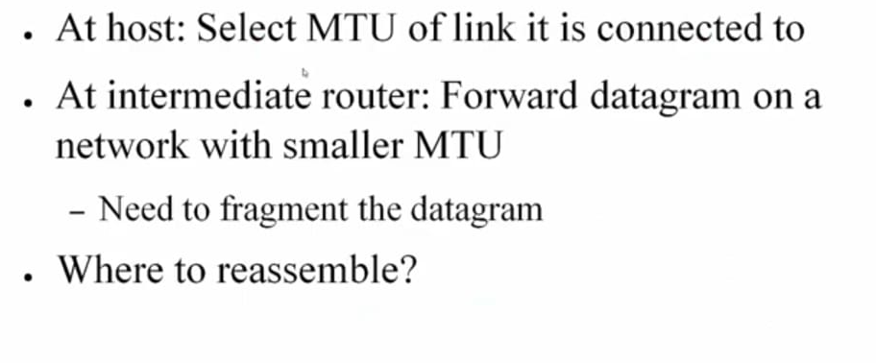
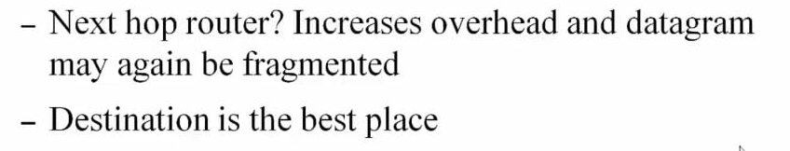

Slide 11
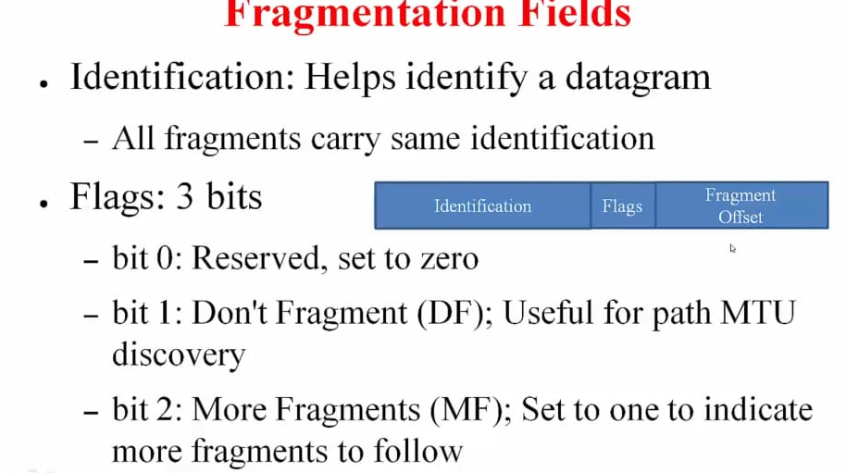

Slide 12
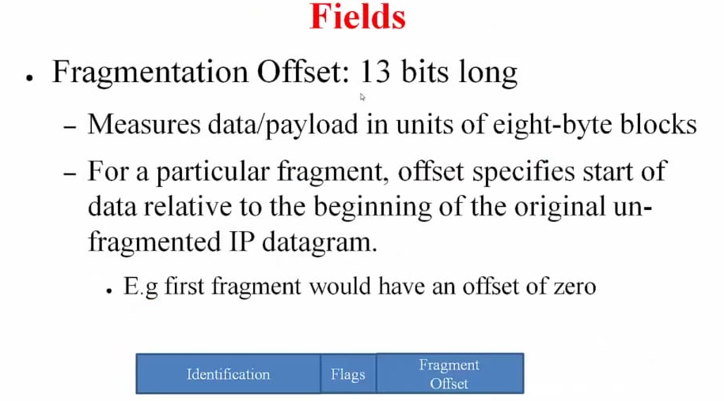

Slide 13
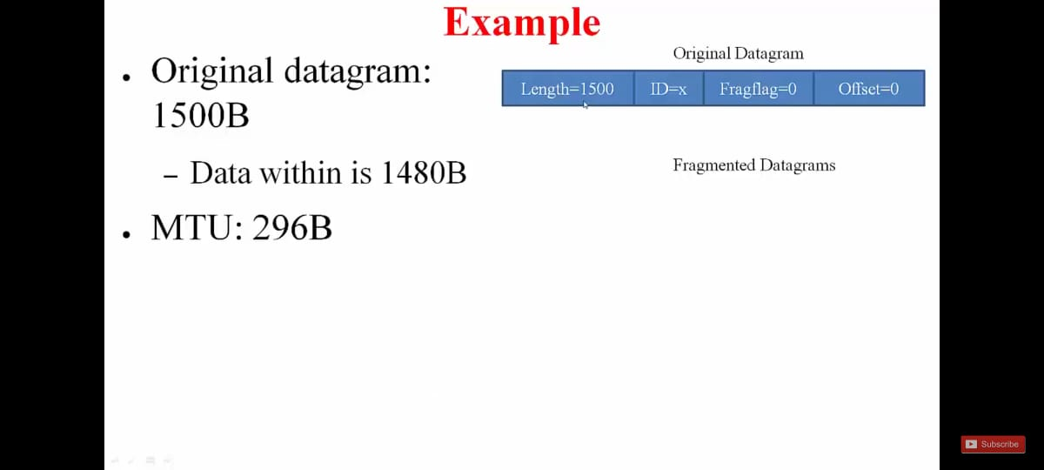

Slide 14
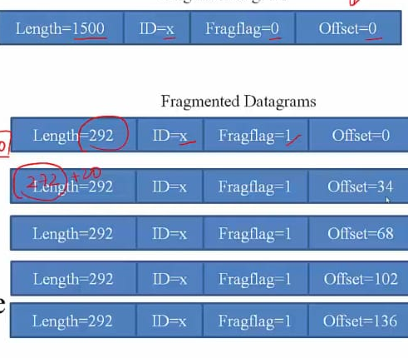

Slide 15
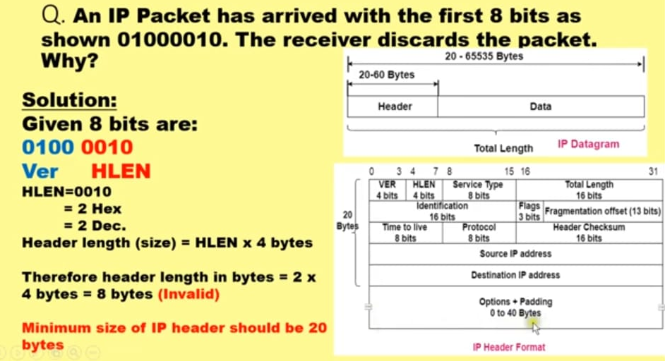

Slide 16
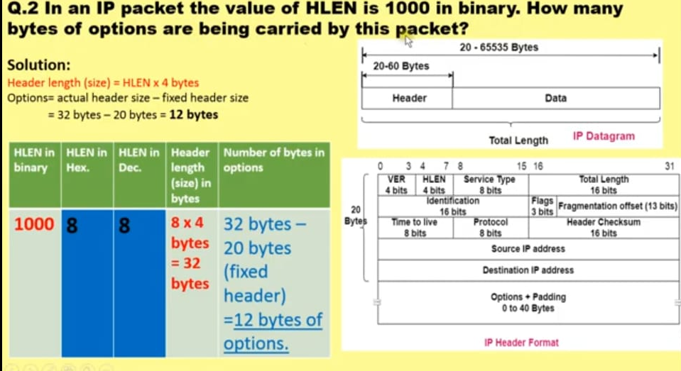

Slide 17
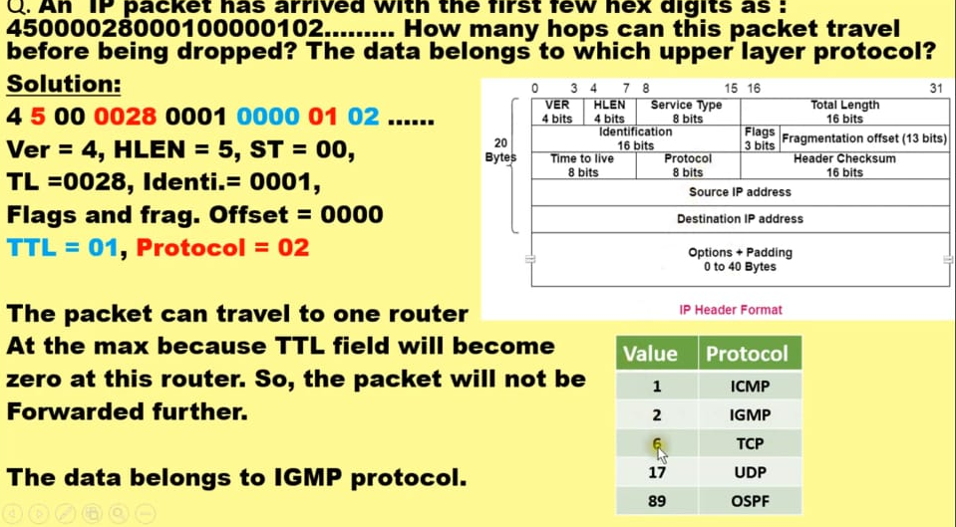

Slide 18
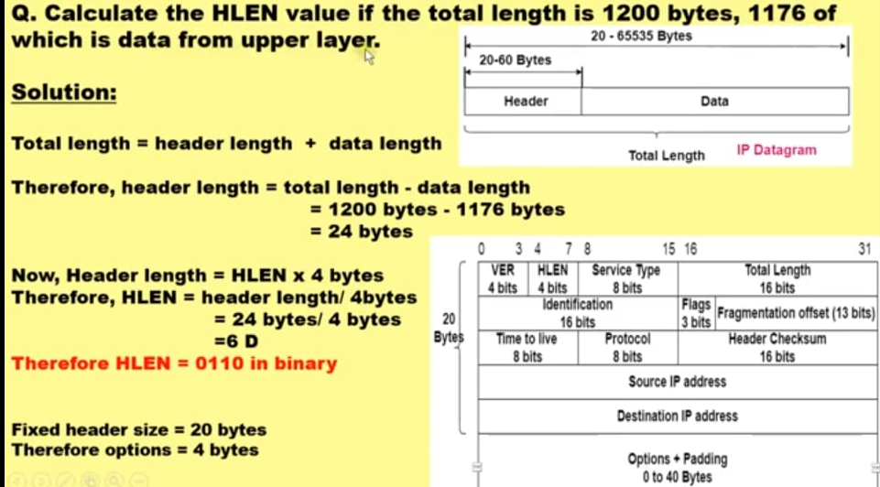

Slide 19
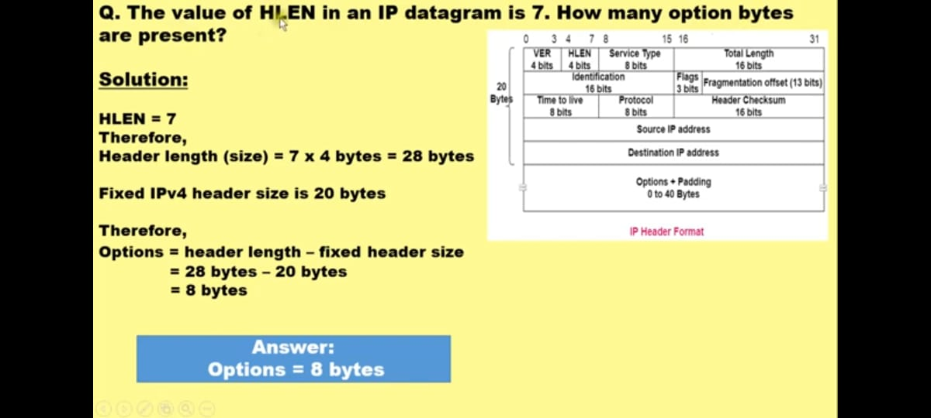

Slide 20
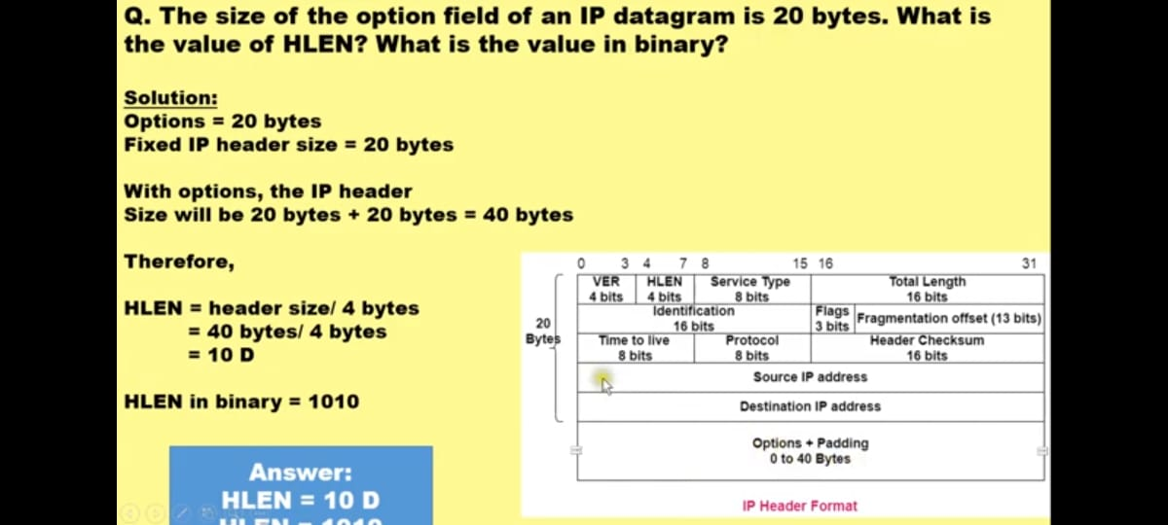

Slide 21
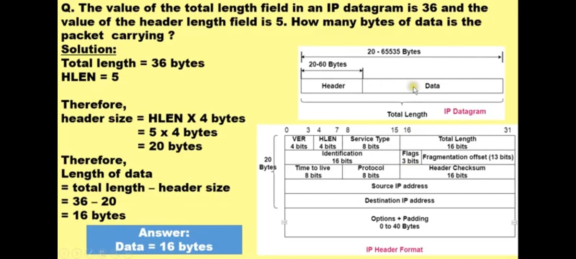

Slide 22


Slide 23
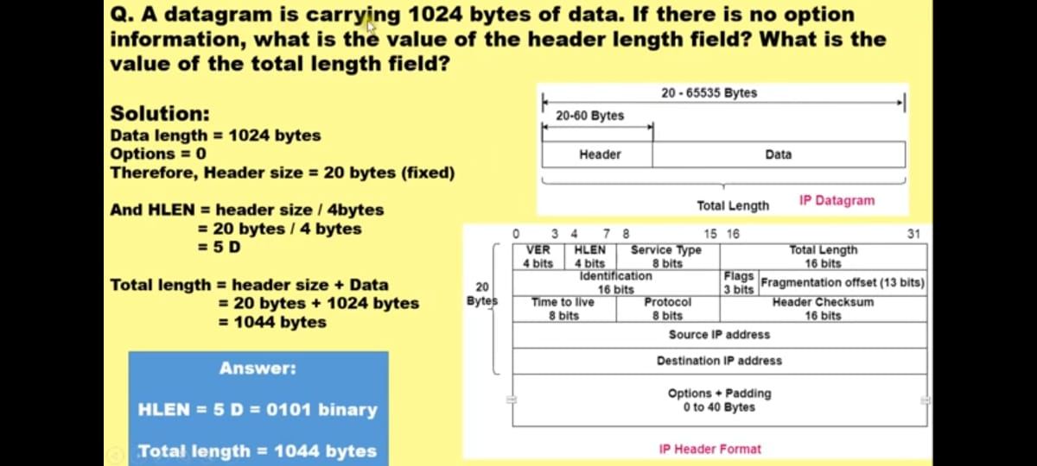

Slide 24
IPv4 has a 32-bit address length | IPv6 has a 128-bit address length
It Supports Manual and DHCP address configuration | It supports Auto and renumbering address configuration
In IPv4 end to end, connection integrity is Unachievable | In IPv6 end-to-end, connection integrity is Achievable
It can generate 4.29×10⁹ address space | The address space of IPv6 is quite large it can produce 3.4×10³⁸ address space
The Security feature is dependent on the application | IPSEC is an inbuilt security feature in the IPv6 protocol
Address representation of IPv4 is in decimal | Address Representation of IPv6 is in hexadecimal
Fragmentation performed by Sender and forwarding routers | In IPv6 fragmentation is performed only by the sender
In IPv4 Packet flow identification is not available | In IPv6 packet flow identification are Available and uses the flow label field in the header
In IPv4 checksum field is available | In IPv6 checksum field is not available
It has a broadcast Message Transmission Scheme | In IPv6 multicast and anycast message transmission scheme is available
In IPv4 Encryption and Authentication facility not provided | In IPv6 Encryption and Authentication are provided
IPv4 has a header of 20-60 bytes. | IPv6 has a header of 40 bytes fixed
IPv4 can be converted to IPv6 | Not all IPv6 can be converted to IPv4
IPv4 consists of 4 fields which are separated by addresses dot (.) | IPv6 consists of 8 fields, which are separated by a colon (:)
IPv4’s IP addresses are divided into five different classes. Class A , Class B, Class C, Class Da , Class E. | IPv6 does not have any classes of the IP address.
IPv4 supports VLSM(Variable Length subnet mask). | IPv6 does not support VLSM.
Example of IPv4: 66.94.29.13 | Example of IPv6: 2001:0000:3238:D

